Slide 1
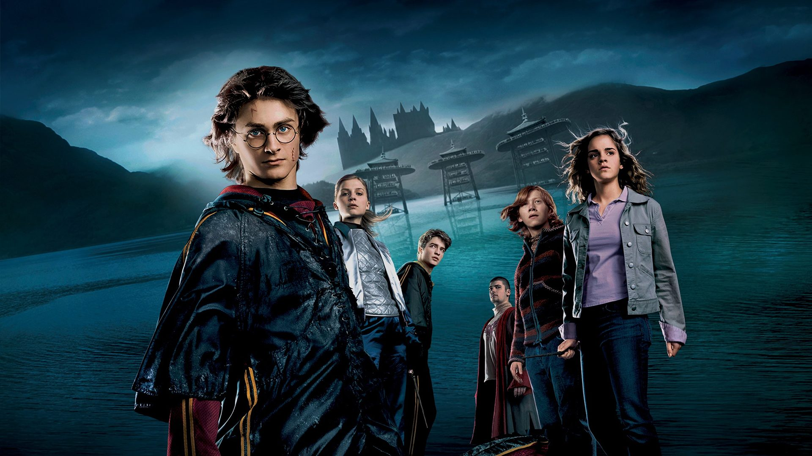
Positivity in Competitive Situations
An Analysis of Characters and their Relationships in J.K. Rowling’s Harry Potter and the Goblet of Fire

Slide 2
Content
Story & Concept
Hypothesis
Methodology & Approach
Analysis and Insights
Sentiment Analysis
Social Network Map
Word Cloud
Conclusion

Slide 3
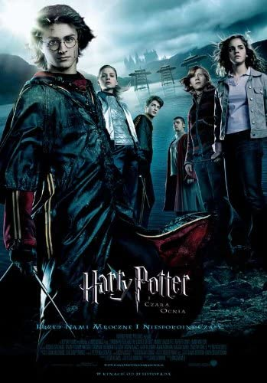
Story & Concept
Fourth book in the Harry Potter Series
Fourth year for Harry, Ron, Hermione
Goblet of Fire
Triwizard Tournament
New characters

Slide 4
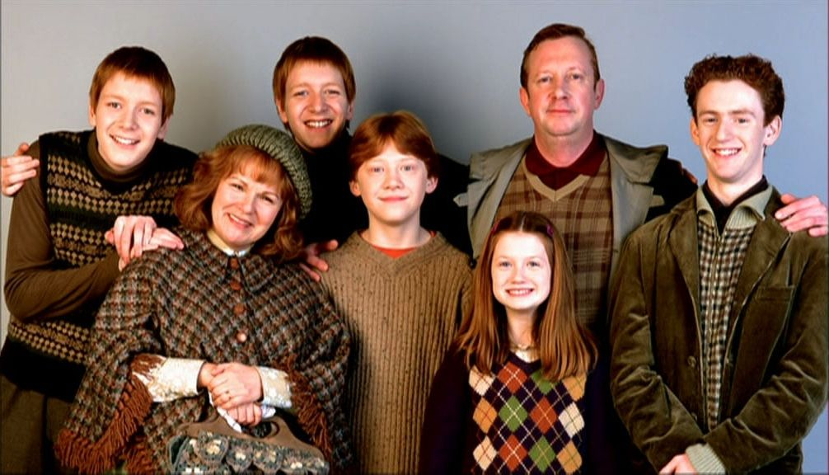
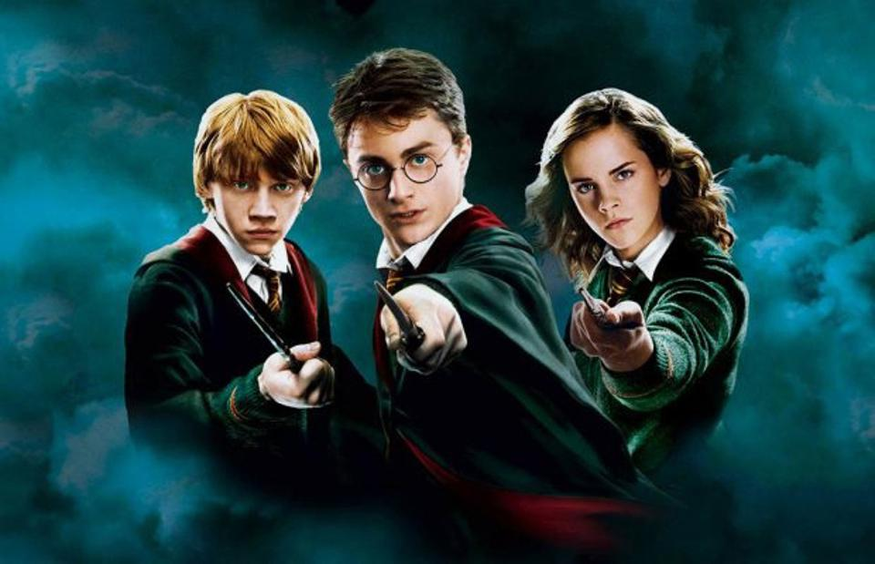
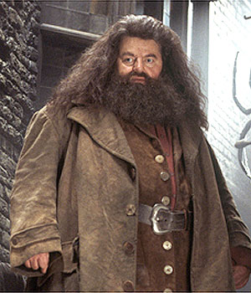
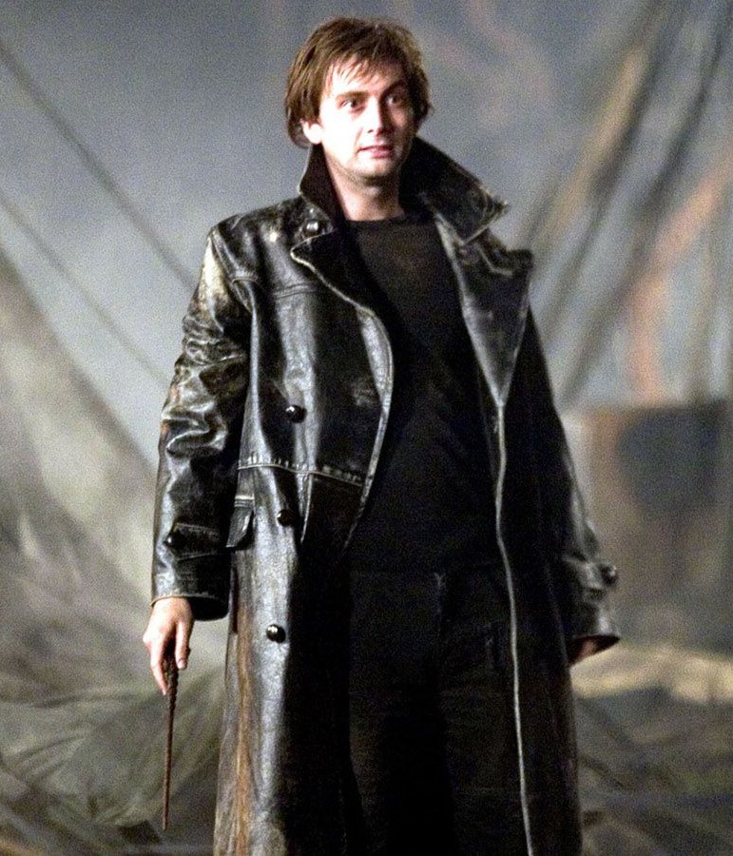
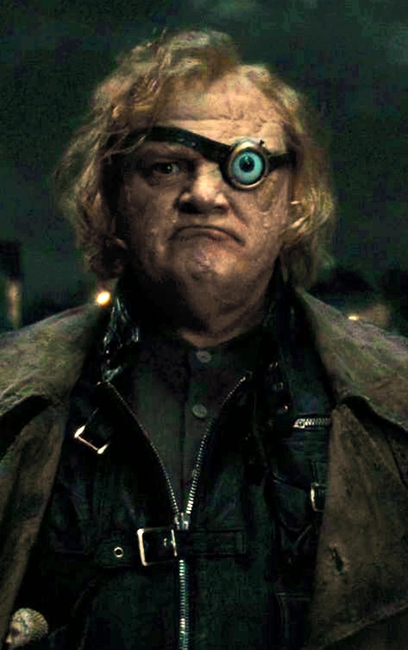
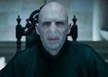
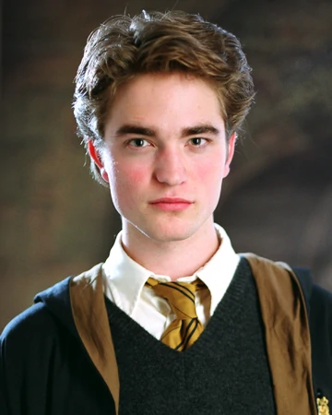
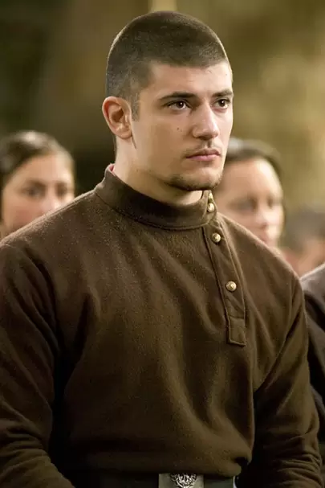
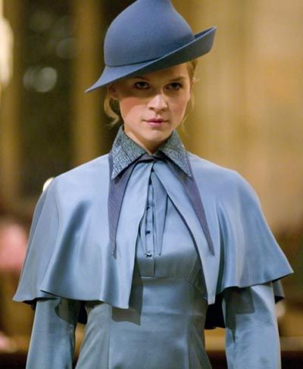
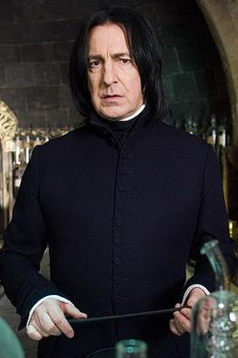
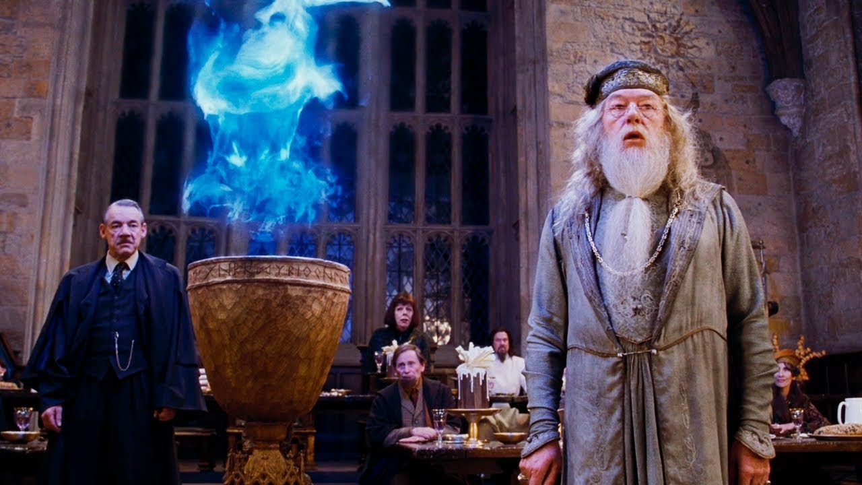
Key Characters
The Weasleys - Fred, George,
Arthur, Percy, Molly, Ron, Ginny
Harry, Ron & Hermione Rubeus Hagrid Barty Crouch Alastor Moody Voldemort
Bartemius Crouch, Cedric Diggory Viktor Krum Fleur Delacour Severus Snape
Dumbledore

Slide 5
Hypothesis
Notes:
Vatsal 5-9

Slide 6
Who is the most trusted character in Harry Potter & the Goblet of Fire?
Notes:
The question on which we are running our hypothesis is who is the most trusted character in Harry Potter and the goblet of fire. The reason why we choose this question is because the movie is based on a tri wizard tournament and trust is a very important part of the movie. When we compare this question to the movie we see that all the characters are strongly interdependent. In the entire movie trust had had become a vital component between the characters be it during the tournament or when facing evil. So through this question we aim to find who is the most trusted character in the movie.

Slide 7
Methodology & Approach

Slide 8
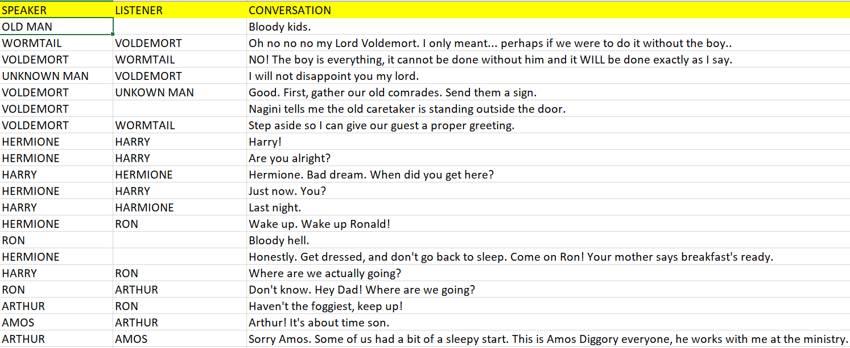
Data Set
Notes:
We broke down the script into three categories speaker, listener and the conversation. We recorded the data in a excel file which we later used to create are analysis. We also had to clean up our data set in R. We removed the blank conversation cells and a few monologues which helped us give a better comparison of conversations between the characters

Slide 9
R Packages
library(wordcloud)
library(lexicon)
library(NLP)
library(RColorBrewer)
library(tm)
library(tokenizers)
library(quickPlot)
library(tidytext)
library(dplyr)
library(igraph)
library(ggplot2)
Notes:
We have used R to create create are analysis. Some of the most important packages which we used are

Slide 10
Analysis and Insights

Slide 11
Social Network Analysis

Slide 12
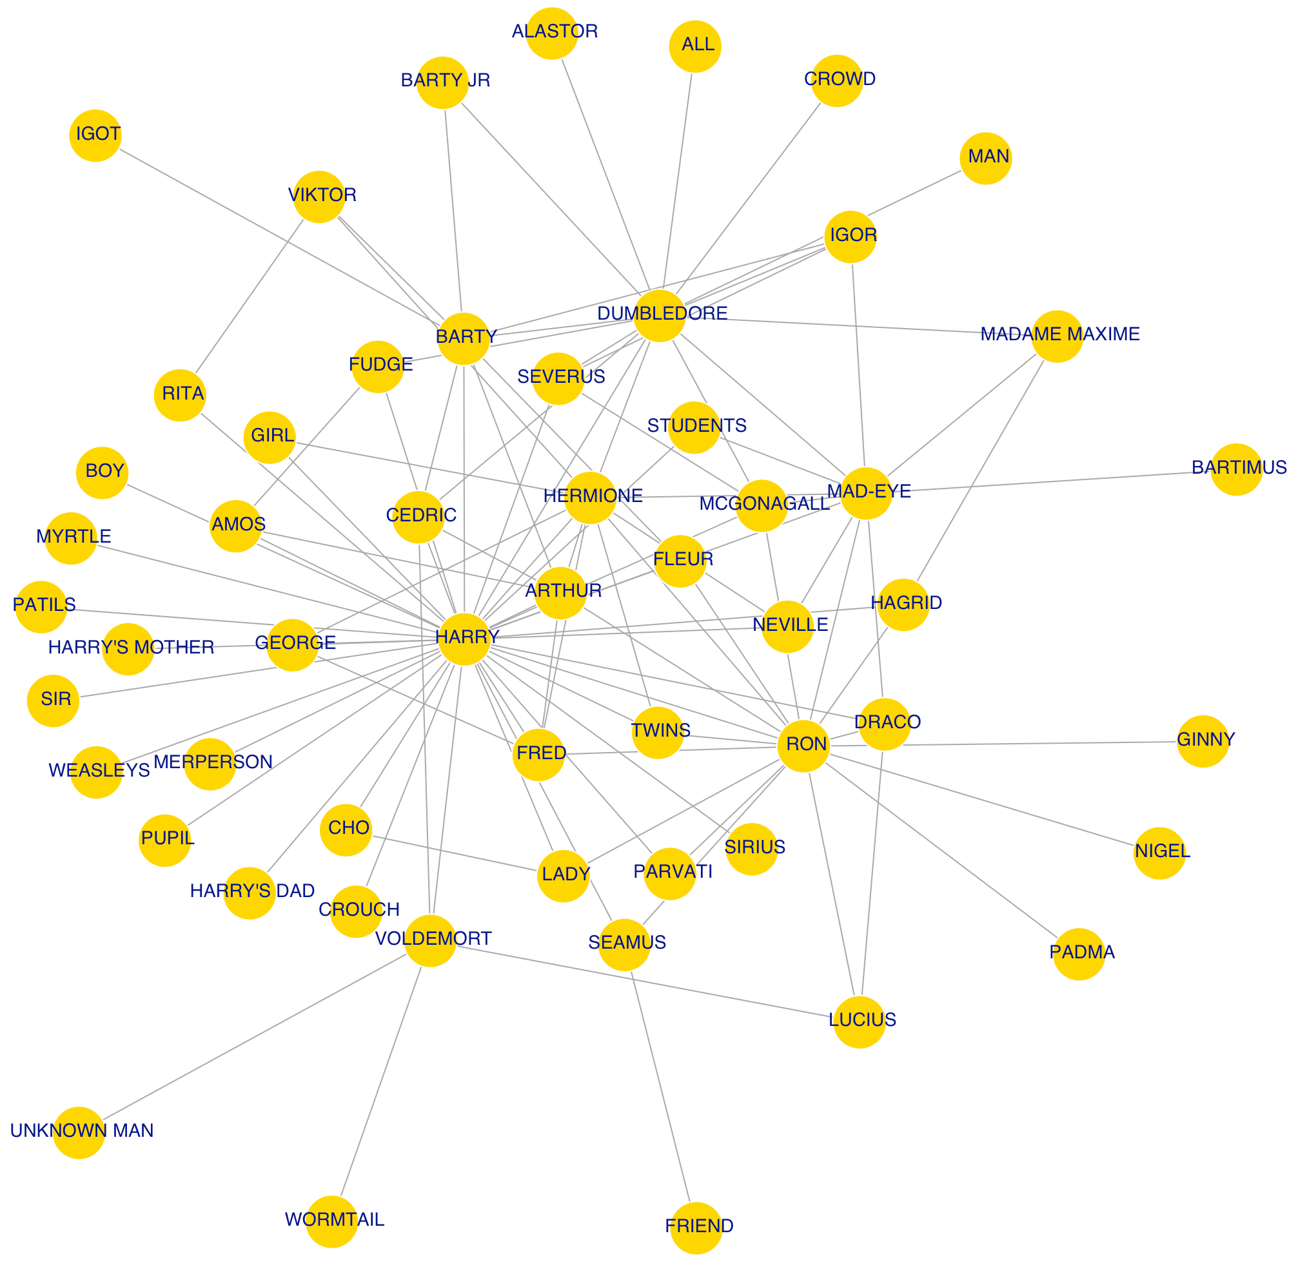
Social Network Map
Notes:
As you all can see in the social network map here, a lot of new characters got introduced in this movie, in addition to the characters that has been there since the previous movies. As we all know, Harry, Ron and Hermione are the three main characters and we can confirm that by seeing the number of degrees or interactions and connections they have around them with Harry having the most, followed by Ron and Hermione. An interesting thing about this social network map is the clusters that seemed to be formed. For instance, at the top you see Dumbledore and the professors that teach at Hogwarts and their interactions and connections while on the right, you see most of the student characters grouped together due to their interactions in the movie, with some exceptions. With Dumbledore being the headmaster, Harry’s connection to him allows him to have other connections, including Mad-Eye. As Harry navigates the situation throughout situation of joining the tournament, Mad-Eye, the new character introduced in this volume, was one of the pivotal characters in the movie as he helped Harry win the tournament but ultimately at the end broke the trust they built as Mad-Eye turned out to be someone else - Bardy Jr.
Maybe also talk about Cedric as well since he will be mentioned in the sentiment analysis
Another way we can see character importance is their interaction with our 3 main characters, Harry, Ron and Hermione

Slide 13
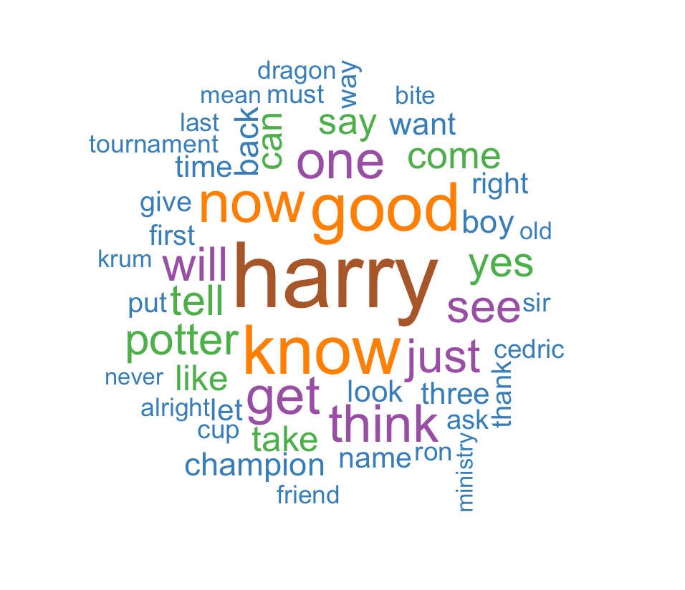
Word Cloud
Notes:
Harry being the main character was mentioned the most number of times. Given also the plot line of the movie, words like tournament, champion and cup were also mentioned a good number of times. The overall sentiment of the movie seems to focus on the trust and anticipation part of things since the movie’s plot surrounds the tournament with the bigger backdrop with Harry meeting Voldemort during the climax of the movie.

Slide 14
Sentiment Analysis
Notes:
Prateek to cover

Slide 15
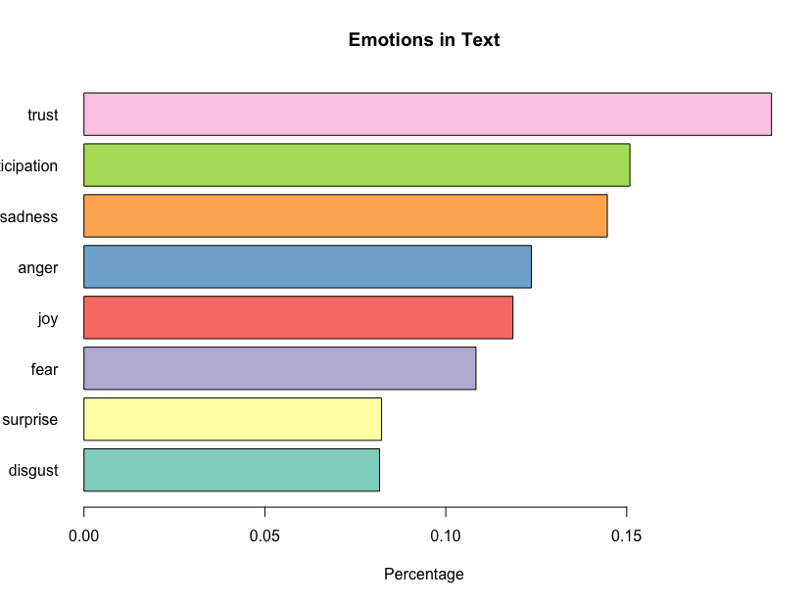
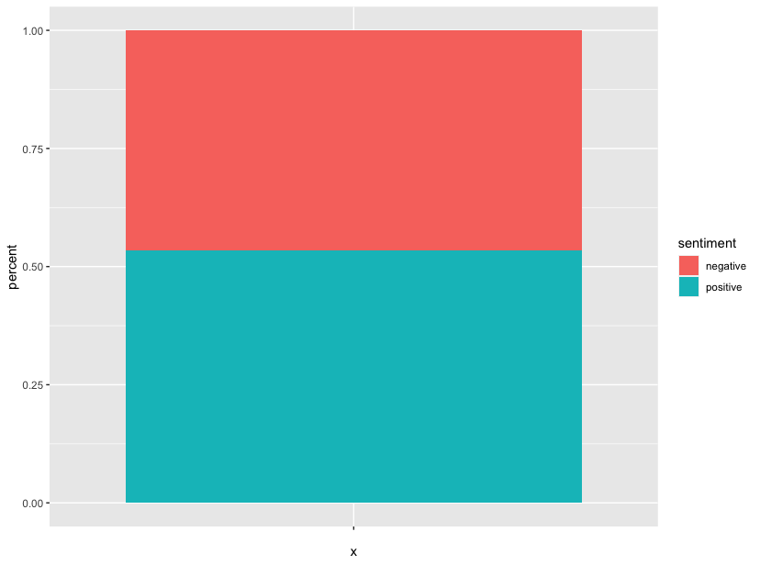
Movie depicts slight positive emotions on the back of emotions like Trust and Joy; however sadness, anger and fear bringing negativity in the theme
Sentiment Analysis: Overall Sentiments and Emotions amongst Characters
Notes:
Sentiments are can be classified as positive or negative sentiments. Further these emotions like Trust, Surprise, Joy depicts Positive sentiments while anger, fear, disgust, sadness displays negative sentiment.
(The chart over left displays percentage share of positive and negative considering the total as the sum their scores)
The overall movie is slight positive (little over 50%) with mainly high degree of trust, anticipation and sadness amongst the characters
The Tournament event in the movie explains high degree of Anticipation, Joy and Surprise
(Assumptions:
There might be several neutral words. % are calculated by taking into account the positive and negatives only
2. Lexicons do not take into account qualifiers into word, for example no good, not true.
)

Slide 16
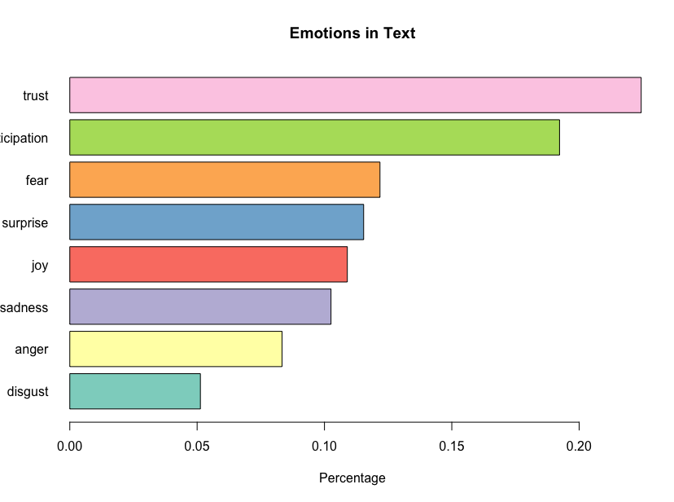
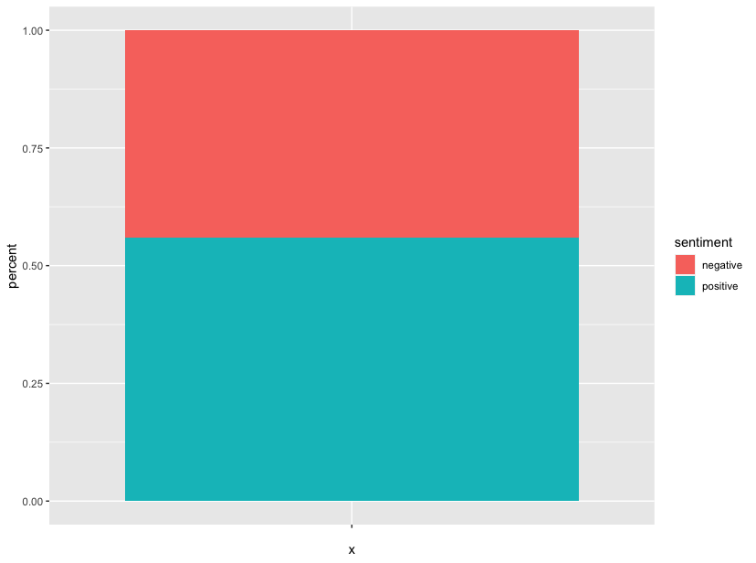
Central Character “Harry” displays slight positive sentiment 56%. He was equally bound by emotions like fear and sadness
Sentiments and Emotions displayed by Main Character- Harry
Notes:
Since the central character was “Harry” which was even established by the network analysis. It was empirical to observe the sentiments and emotions of Harry.
As per the analysis, Harry displays slight positive sentiment ( 56%). On the right hand side, the chart displays the percentage score of emotions.
Harry displays good amount of trust. Harry’s anticipation score clearly shows his curiosity.

Slide 17
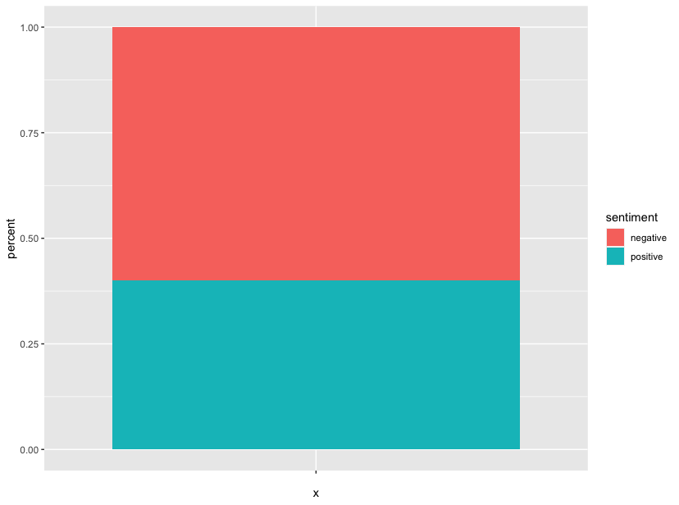
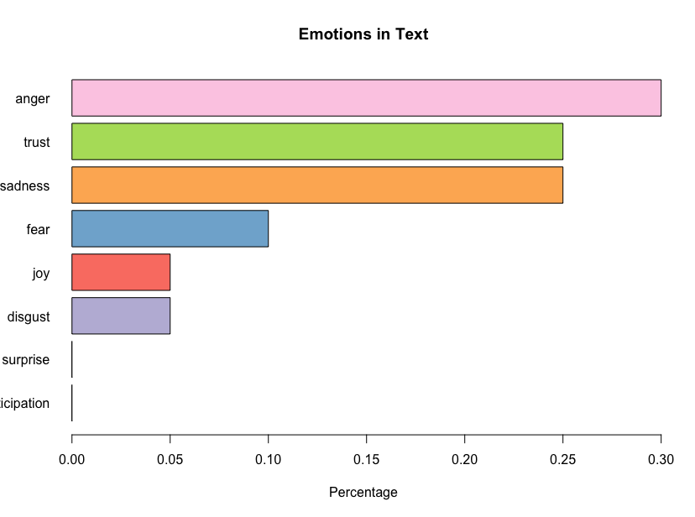
Another lead character “Cedric” has negative role displaying anger and sadness
Sentiments and Emotions displayed by Main Character- Cedric
Notes:
Cedric : another important character displays negative role with high degree of anger and sadness

Slide 18

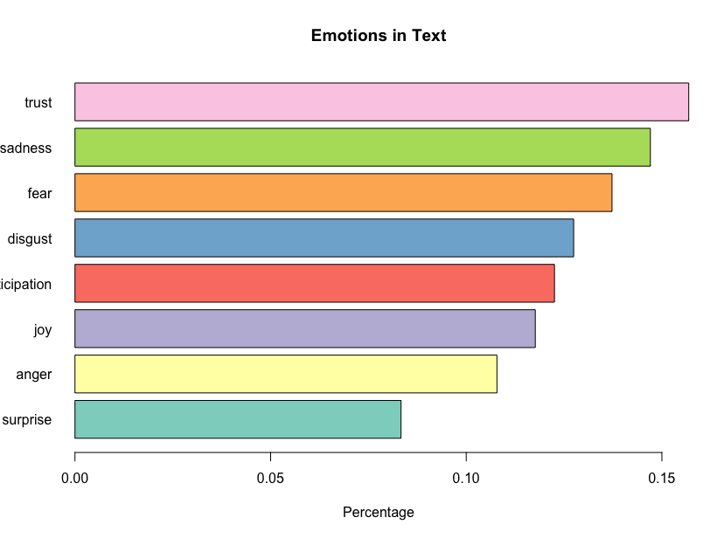
Mad-Eye: Contrast to the notion, script hints him as a slight positive character having high degree of trust
Sentiments and Emotions displayed by Main Character- Mad-Eye
Notes:
Mad-eye : As we have all seen in the movie and we know that Mad eye was impersonated by voldemort and he was having other ulterior motives for Harry but in the movie he guided Harry Potter with the tournament. Hence contrary to the notion of him being a “BAD GUY” in the movie, his character has positive sentiments

Slide 19
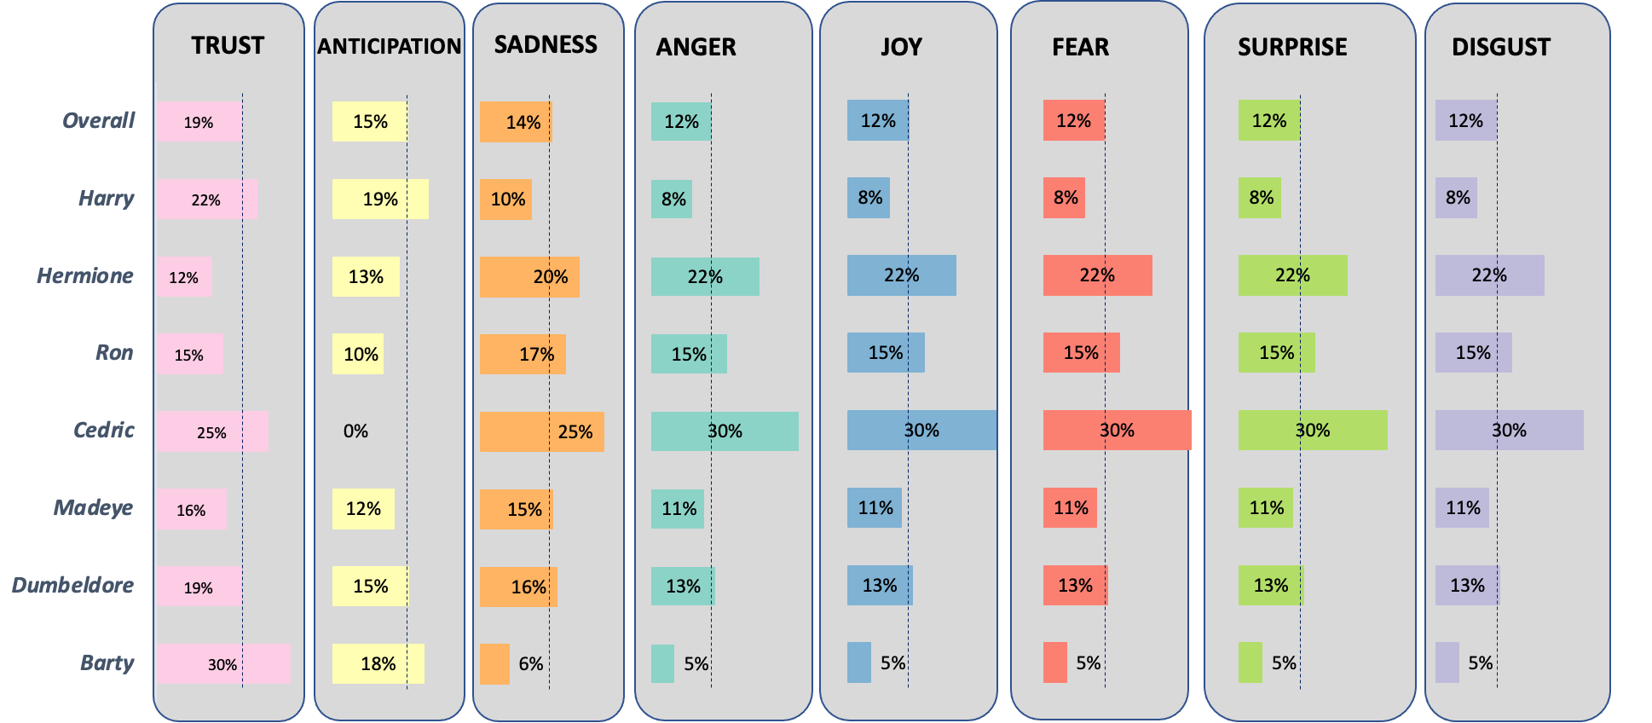
Trust: Harry is a trustworthy character along with Cedric and Barty
Comparison chart of Emotions in all characters
Notes:
This analysis compares the emotions of all characters and are benchmarked with the overall theme of the movie.
Harry is a trustworthy character clearly indicated by his above benchmarked Trust score of 22%. Along with Harry, Cedric and Barty are also trustworthy characters. With 25% and 30% as their trust scores
(As we have seen in the movie Cedric was kind to Harry as opposed to everyone else of assuming that Harry was lying about not putting his name in the Goblet of Fire. Harry even informed him about the first task about dragons in the tournament. These scenes clearly correlates with the emotions score of trust amongst these characters.)
Cedric and Harry trusted each other, even though they were competitors. This is because they are both from the same house,they also exchanged clues and information on the competition, which made a special bond between the two. Therefore, despite having a negative score 56%(which we have scene couple of slides back), Cedric was a trusted ally, clearly indicated by his trust score.
Barty is the Prime Minister of Magic, a highly respected man. Barty puts faith and courage in Harry and even helps him outside of the tournament, which implies that he cares about Harry , hence having a high trust score.

Slide 20
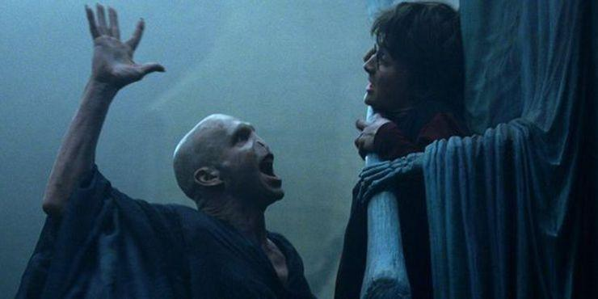
Conclusion

